Slide 1
Database Normalization

Slide 2
Definition
This is the process which allows you to window out redundant data within your database.
This involves restructuring the tables to successively meeting higher forms of Normalization.
A properly normalized database should have the following characteristics
  Scalar values in each fields
  Absence of redundancy.
  Minimal use of null values.
  Minimal loss of information.

Slide 3
Levels of Normalization
Levels of normalization based on the amount of redundancy in the database.
Various levels of normalization are:
  First Normal Form (1NF)
  Second Normal Form (2NF)
  Third Normal Form (3NF)
  Boyce-Codd Normal Form (BCNF)
Redundancy
Number of Tables
Complexity
Most databases should be 3NF or BCNF in order to avoid the database anomalies.

Slide 4
Levels of Normalization
1NF
2NF
3NF
BCNF
Each higher level is a subset of the lower level

Slide 5
First Normal Form (1NF)
A table is considered to be in 1NF if all the fields contain
only scalar values (as opposed to list of values).
Example (Not 1NF)
ISBN
Title
AuName
AuPhone
PubName
PubPhone
Price
0-321-32132-1
Balloon
Sleepy, Snoopy, Grumpy
321-321-1111, 232-234-1234, 665-235-6532
Small House
714-000-0000
$34.00
0-55-123456-9
Main Street
Jones, Smith
123-333-3333, 654-223-3455
Small House
714-000-0000
$22.95
0-123-45678-0
Ulysses
Joyce
666-666-6666
Alpha Press
999-999-9999
$34.00
1-22-233700-0
Visual Basic
Roman
444-444-4444
Big House
123-456-7890
$25.00
Author and AuPhone columns are not scalar
Notes:
Having scalar values also means that all instances of a record type must contain the same number of fields.
A table not in first normal form is called un normalized

Slide 6
1NF - Decomposition
Place all items that appear in the repeating group in a new table
Designate a primary key for each new table produced.
Duplicate in the new table the primary key of the table from which the repeating group was extracted or vice versa.
Example (1NF)
ISBN
AuName
AuPhone
0-321-32132-1
Sleepy
321-321-1111
ISBN
Title
PubName
PubPhone
Price
0-321-32132-1
Snoopy
232-234-1234
0-321-32132-1
Balloon
Small House
714-000-0000
$34.00
0-321-32132-1
Grumpy
665-235-6532
0-55-123456-9
Main Street
Small House
714-000-0000
$22.95
0-55-123456-9
Jones
123-333-3333
0-123-45678-0
Ulysses
Alpha Press
999-999-9999
$34.00
0-55-123456-9
Smith
654-223-3455
1-22-233700-0
Visual Basic
Big House
123-456-7890
$25.00
0-123-45678-0
Joyce
666-666-6666
1-22-233700-0
Roman
444-444-4444
Notes:
1. The designated key will be the primary key of the original table concatenated with one or more data items from the new table.
For the first table the primary key is ISBN
For the second table the primary key is ISBN + Author Name

Slide 7
Functional Dependencies
If one set of attributes in a table determines another set of attributes in the table, then the second set of attributes is said to be functionally dependent on the first set of attributes.
Example 1
ISBN
Title
Price
Table Scheme: {ISBN, Title, Price}
Functional Dependencies: {ISBN} → {Title}
{ISBN} → {Price}
0-321-32132-1
Balloon
$34.00
0-55-123456-9
Main Street
$22.95
0-123-45678-0
Ulysses
$34.00
1-22-233700-0
Visual Basic
$25.00
Notes:
Notes to Instructor: Need more rigor in the functional dependencies. With a few examples. May be create a class assignment for functional dependencies.

Slide 8
Functional Dependencies
Example 2
Table Scheme: {PubID, PubName, PubPhone}
Functional Dependencies: {PubId} → {PubPhone}
{PubId} → {PubName}
{PubName, PubPhone} → {PubID}
PubID
PubName
PubPhone
1
Big House
999-999-9999
2
Small House
123-456-7890
3
Alpha Press
111-111-1111
Example 3
AuID
AuName
AuPhone
Table Scheme: {AuID, AuName, AuPhone}
Functional Dependencies: {AuId} → {AuPhone}
{AuId} → {AuName}
{AuName, AuPhone} → {AuID}
1
Sleepy
321-321-1111
2
Snoopy
232-234-1234
3
Grumpy
665-235-6532
4
Jones
123-333-3333
5
Smith
654-223-3455
6
Joyce
666-666-6666
7
Roman
444-444-4444

Slide 9
FD – Example
Database to track reviews of papers submitted to an academic conference. Prospective authors submit papers for review and possible acceptance in the published conference proceedings. Details of the entities
  Author information includes a unique author number, a name, a mailing address, and a unique (optional) email address.
  Paper information includes the primary author, the paper number, the title, the abstract, and review status (pending, accepted,rejected)
  Reviewer information includes the reviewer number, the name, the mailing address, and a unique (optional) email address
  A completed review includes the reviewer number, the date, the paper number, comments to the authors, comments to the program chairperson, and ratings (overall, originality, correctness, style, clarity)

Slide 10
FD – Example
Functional Dependencies
  AuthNo → AuthName, AuthEmail, AuthAddress
  AuthEmail → AuthNo
  PaperNo → Primary-AuthNo, Title, Abstract, Status
  RevNo → RevName, RevEmail, RevAddress
  RevEmail → RevNo
  RevNo, PaperNo → AuthComm, Prog-Comm, Date, Rating1, Rating2, Rating3, Rating4, Rating5

Slide 11
Second Normal Form (2NF)
For a table to be in 2NF, there are two requirements
  The database is in first normal form
  All nonkey attributes in the table must be functionally dependent on the entire primary key
Note: Remember that we are dealing with non-key attributes
Example 1 (Not 2NF)
Scheme → {Title, PubId, AuId, Price, AuAddress}
  Key → {Title, PubId, AuId}
  {Title, PubId, AuID} → {Price}
  {AuID} → {AuAddress}
  AuAddress does not belong to a key
  AuAddress functionally depends on AuId which is a subset of a key

Slide 12
Second Normal Form (2NF)
Example 2 (Not 2NF)
Scheme → {City, Street, HouseNumber, HouseColor, CityPopulation}
  key → {City, Street, HouseNumber}
  {City, Street, HouseNumber} → {HouseColor}
  {City} → {CityPopulation}
  CityPopulation does not belong to any key.
  CityPopulation is functionally dependent on the City which is a proper subset of the key
Example 3 (Not 2NF)
Scheme → {studio, movie, budget, studio_city}
  Key → {studio, movie}
  {studio, movie} → {budget}
  {studio} → {studio_city}
  studio_city is not a part of a key
  studio_city functionally depends on studio which is a proper subset of the key
Notes:
Let us consider the problems with the movie studio database:
Redundancy – City Population is repeated many times
Insertion anomaly – Whenever we add a new record we have to add unnecessary information. We can not add record until we know information about the city population
Deletion anomaly – Whenever we delete a record, useful information is deleted.
Update anomaly – The City Population needs to be updated in more than one location if it changes.

Slide 13
2NF - Decomposition
If a data item is fully functionally dependent on only a part of the primary key, move that data item and that part of the primary key to a new table.
If other data items are functionally dependent on the same part of the key, place them in the new table also
Make the partial primary key copied from the original table the primary key for the new table.
Example 1 (Convert to 2NF)
  Old Scheme → {Title, PubId, AuId, Price, AuAddress}
  New Scheme → {Title, PubId, AuId, Price}
  New Scheme → {AuId, AuAddress}
Notes:
If there is a table with columns A,B,C,D with Primary Key (A,B) & D is dependant on A (alone) then to be 2NF, you should reduce (split) tables as:
Table with columns A,D with Primary Key (A)
Table with columns A,B,C with Primary Key (A,B)

Slide 14
2NF - Decomposition
Example 2 (Convert to 2NF)
  Old Scheme → {Studio, Movie, Budget, StudioCity}
  New Scheme → {Movie, Studio, Budget}
  New Scheme → {Studio, City}
Example 3 (Convert to 2NF)
  Old Scheme → {City, Street, HouseNumber, HouseColor, CityPopulation}
  New Scheme → {City, Street, HouseNumber, HouseColor}
  New Scheme → {City, CityPopulation}

Slide 15
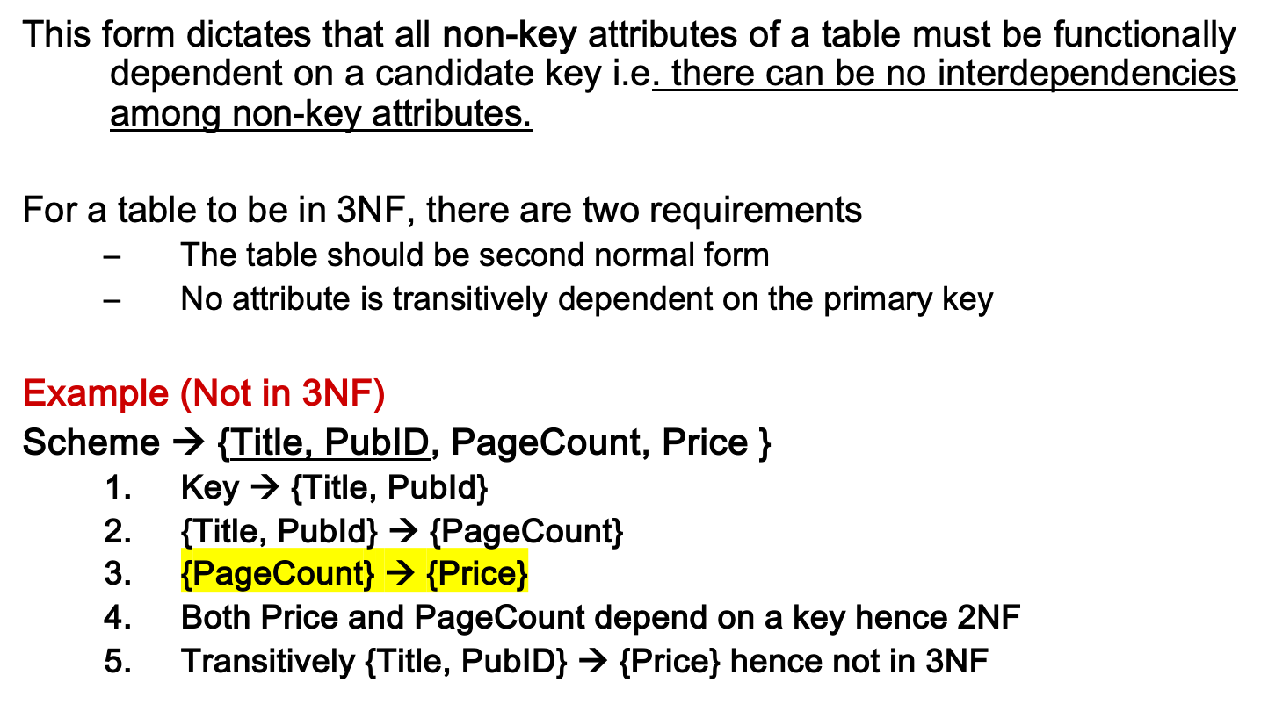
Third Normal Form (3NF)
Notes:
In the Book Schema Third Normal Form is violated since a non-key field is dependent on another non-key field and is transitively dependent on the primary key.

Slide 16
Third Normal Form (3NF)
Example 2 (Not in 3NF)
Scheme → {Studio, StudioCity, CityTemp}
  Primary Key → {Studio}
  {Studio} → {StudioCity}
  {StudioCity} → {CityTemp}
  {Studio} → {CityTemp}
  Both StudioCity and CityTemp depend on the entire key hence 2NF
  CityTemp transitively depends on Studio hence violates 3NF
Example 3 (Not in 3NF)
Scheme → {BuildingID, Contractor, Fee}
  Primary Key → {BuildingID}
  {BuildingID} → {Contractor}
  {Contractor} → {Fee}
  {BuildingID} → {Fee}
  Fee transitively depends on the BuildingID
  Both Contractor and Fee depend on the entire key hence 2NF
BuildingID
Contractor
Fee
100
Randolph
1200
150
Ingersoll
1100
200
Randolph
1200
250
Pitkin
1100
300
Randolph
1200
Notes:
Let us consider the problems with the movie studio database:
Redundancy – City Population is repeated many times
Insertion anomaly – Whenever we add a new record we have to add unnecessary information. We can not add record until we know information about the city population
Deletion anomaly – Whenever we delete a record, useful information is deleted.
Update anomaly – The City Population needs to be updated in more than one location if it changes.

Slide 17
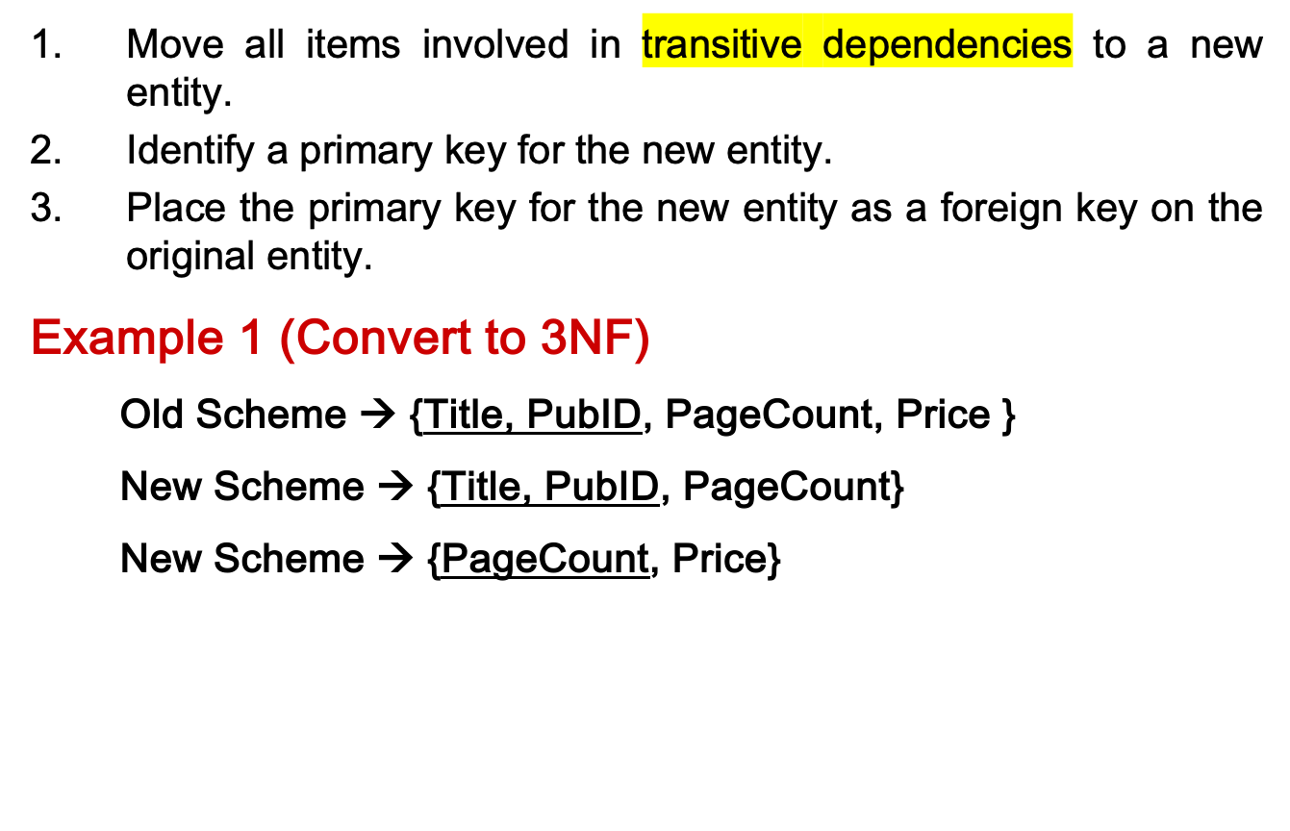
3NF - Decomposition
Notes:
If there is a table with columns A,B,C with Primary Key (A) and C is dependant on B (B → C) then to be 3NF, the tables become
Table with columns B,C with Primary Key (B)
Table with fields A,B with Primary Key ( A), and Foreign Key (B)

Slide 18
3NF - Decomposition
Example 2 (Convert to 3NF)
  Old Scheme → {Studio, StudioCity, CityTemp}
  New Scheme → {Studio, StudioCity}
  New Scheme → {StudioCity, CityTemp}
Example 3 (Convert to 3NF)
  Old Scheme → {BuildingID, Contractor, Fee}
  New Scheme → {BuildingID, Contractor}
  New Scheme → {Contractor, Fee}
BuildingID
Contractor
Contractor
Fee
100
Randolph
Randolph
1200
150
Ingersoll
Ingersoll
1100
200
Randolph
Pitkin
1100
250
Pitkin
300
Randolph

Slide 19
Decomposition – Loss of Information
If decomposition does not cause any loss of information it is called a lossless decomposition.
If a decomposition does not cause any dependencies to be lost it is called a dependency-preserving decomposition.
Any table scheme can be decomposed in a lossless way into a collection of smaller schemas that are in BCNF form. However the dependency preservation is not guaranteed.
Any table can be decomposed in a lossless way into 3rd normal form that also preserves the dependencies.
  3NF may be better than BCNF in some cases
Use your own judgment when decomposing schemas

Slide 20
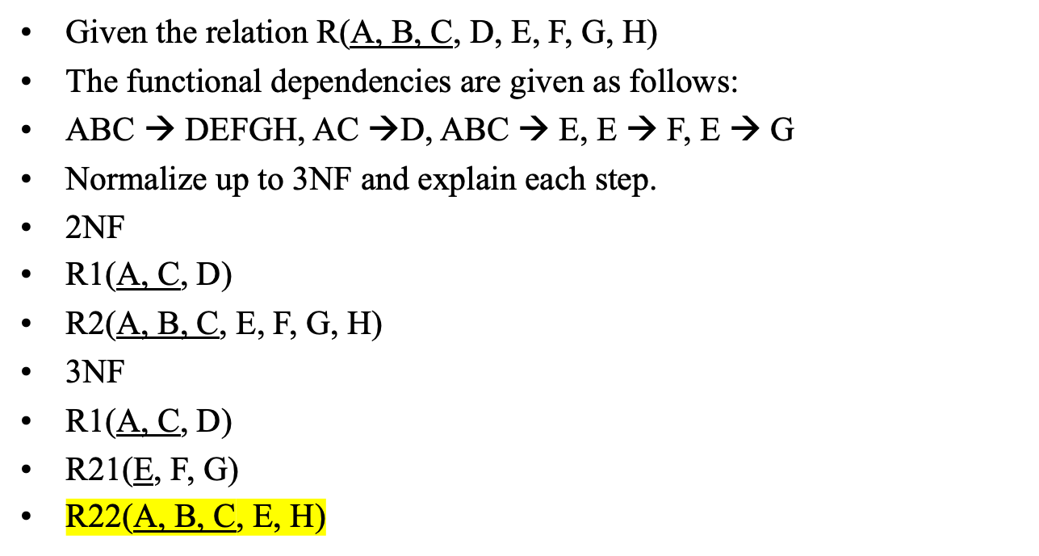

Slide 21
SUMMAY
CHCK 1NF – NO Multivariable Atributes
1NF Decomposition: Reduce all multiple value
CHECK 2NF – 1NF, NO Partial Dependency (Non Key on Primary Key)
2NF Decomposition: Schema for Partially-Dependent attribute
CHECK 3NF – 2NF, NO Transitive Dependency(Non Key on Non Key)
3NF Decomposition: Schema for partially dependent attribute

